Slide 1
Modeling and Analysis of the Course Retention and Graduation Rates of Engineering Students
Notes:
[Mico]
Good afternoon, everyone.
Today, we will be presenting our project on the Modeling and Analysis of the Course Retention and Graduation Rates of Engineering Students.

Slide 2
Outline
Project Background
Problem
Objectives
Contributions
Design Overview
Methodology, Results and Analysis
Data Pre-Processing
Feature Selection
Testing
Prediction Models
Descriptive Analysis
Conclusions and Recommendations
Notes:
[Mico]
This is the outline of our presentation.

Slide 3
Project Background
Notes:
[Mico]
The Project Background will be discussed by Elisha and Regis.

Slide 4
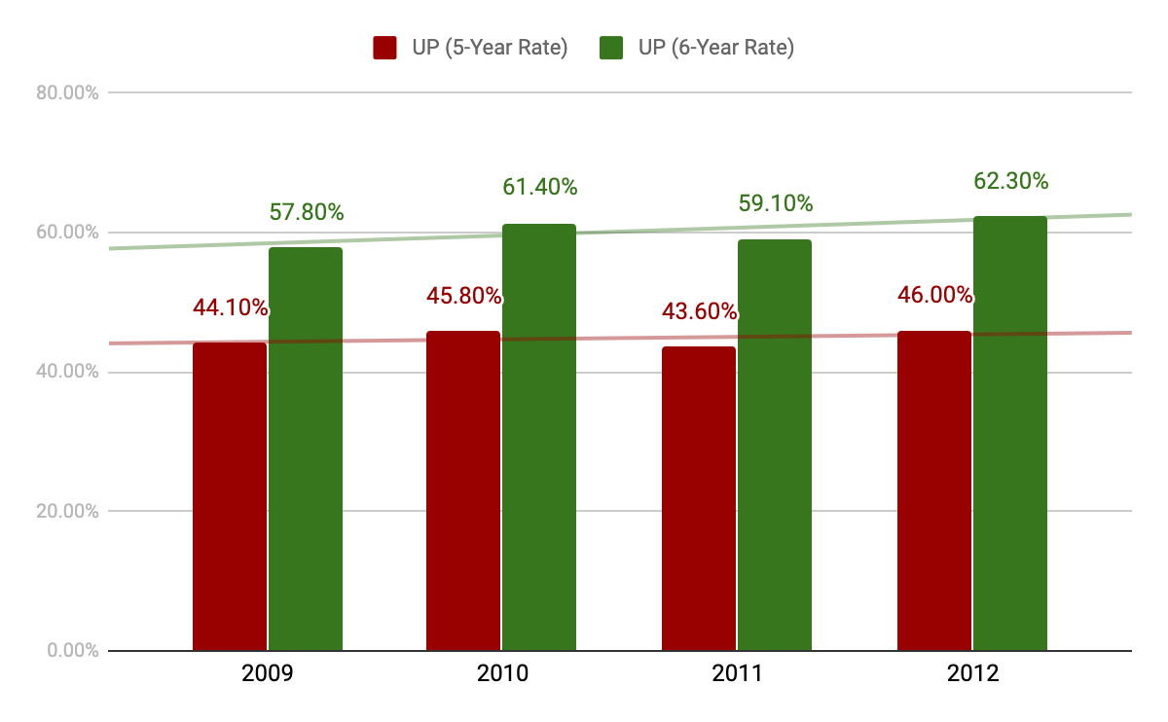
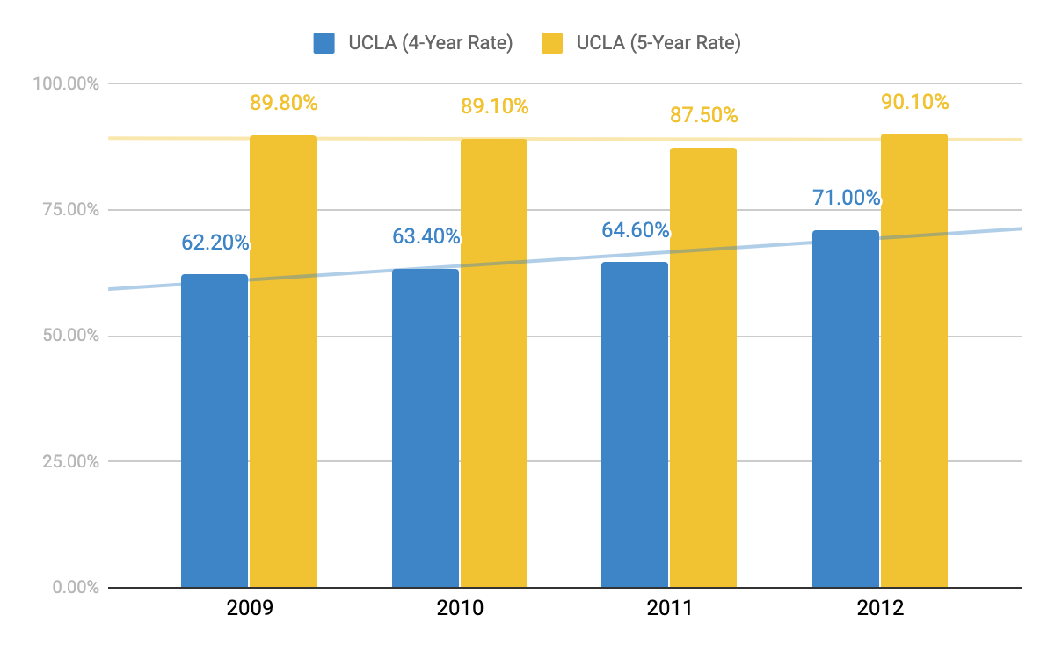
Project Background
Problem
UP Diliman College of Engineering Graduation Rate (2009-2012)
UCLA School of Engineering and Applied Science
Graduation Rate (2009-2012) [1]
Low retention and graduation rates
in the UP Diliman College of Engineering.
Sources:
[1] UCLA APB. Graduation & Time to Degree. https://www.apb.ucla.edu/campus-statistics/graduation-ttd, 2020
Notes:
[Elisha] This project was started because of the noticeable low graduation and retention rates within the College of Engineering here in UP Diliman compared to other Engineering Schools overseas. Here in the diagram, we can see the decline of graduation rates of freshmen who enter the college every year starting from 2009 up to 2012. This in comparison with University of California, Los Angeles’ (UCLA) School of Engineering and Applied Science, displays that UP COE’s rates are significantly lower than that of UCLA’s.
But even in an efficiency perspective, the low graduation and retention rates prove to be a problem to the college as it displays that the college is producing significantly fewer graduates than it initially took in. The problem arises due to students shifting, dropping, or get delayed at college and there is a need to identify the factors that causes students to shift, drop, and get delayed. The lack of studies that focuses on these risk factors hinders the faculty members and the administration to effectively draft policies and provide such intervention to student. These are the problems we wish to solve through our project.

Slide 5


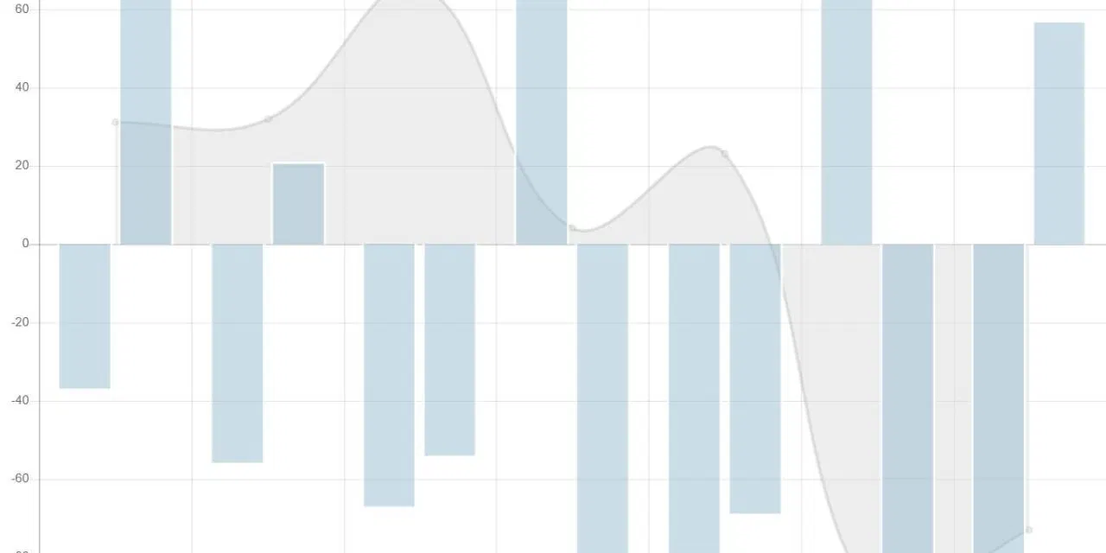

Project Background
Objectives
Determine risk factors
Provide descriptive analysis
of risk factors
Predict graduation
and retention rates
Images from:
https://www.tpr.org/post/school-graduation-rates-are-deceiving-here-are-7-things-would-help
https://www.creatrixcampus.com/blog/7-reasons-why-students-drop-out
https://onaircode.com/bootstrap-graph-charts-examples/
Notes:
[Regis]
The goal of this project is broken down into three parts.
Firstly, we want to determine the possible risk factors that are linked to a student’s time to graduate or his/her course retention. There are plenty of different features in the data set, but not all of them will be significant enough to influence the output class. To find out which are significant or not, we will be using the chi square test of independence for categorical data, then correlation coefficient for continuous data.
Secondly, we want to build three different prediction models to accurately predict both time to graduate and course retention. We have defined accurate to be above 70% overall accuracy, and how this accuracy is to be obtained will be discussed further in the methodology.
Lastly, we want to provide a descriptive analysis of the risk factors. This will not include all because some factors have been deemed insignificant relative to our output class, the time to graduate or the course retention. Nevertheless, we want to provide statistical data on factors that are significant to the output, and this will help provide an idea of how these different factors affect the output classes.

Slide 6

Project Background
Contributions
Improve course retention and graduation rates
Informed advice for students by faculty members
Images from:
https://www.tpr.org/post/school-graduation-rates-are-deceiving-here-are-7-things-would-help
https://onaircode.com/bootstrap-graph-charts-examples/
Notes:
[Regis]
After we have finished the project, these are the contributions that our completed work wish to achieve.
The first contribution is to improve course retention and graduation rates for the College of Engineering. The output of our project allows college administrators to grasp an insight of the current state of the college. While it is true that they have the current retention and graduation rates, our project provides descriptive analysis of different factors that possibly affect these two rates. With this, it is possible for the administrators to draft policies that can help remedy the problem.
The next contribution is to aid faculty members in giving informed advice. Through the use of our developed models and analysis of features, students will receive advice better suited towards their needs, especially if they are lacking in one factor or another.

Slide 7
Project Background
Design Overview
Feature Selection
Prediction Model Development
Descriptive Analysis
Notes:
[Elisha] For this project we would have this design. First of all, from the dataset of UP College of Engineering we took features that are significant to a student’s time to graduation and course retention. After identifying which factors affect time to graduation and course retention, they would now be used to train and test the models. The prediction models are split into three, Decision Trees, Probabilistic Model, and Support Vector Machines. At the same time, the prediction models have a goal to reach at least 70% accuracy to make predicting more efficient. This is to see the potential pros and cons of each model in predicting time to graduation and course retention. Finally we would like to give insight on how the factors from feature selection affect a student’s time to graduation and course retention through descriptive analysis. Here we will see the trends of each factor.

Slide 8
Data Pre-Processing
Methodology, Results and Analysis

Slide 9
Data Pre-Processing
Methodology
Feature | Data Type
No. of Semesters Enrolled | Continuous
Year and Semester of First Enrolment | Continuous
Year and Semester of Last Enrolment | Continuous
Sex | Categorical
Country of Citizenship | Categorical
Civil Status | Categorical
Religion | Categorical
STFAP/STS Bracket (Upon Graduation) | Categorical
STFAP/STS Bracket (Upon Entry) | Categorical
No. of Sems with Scholarship | Continuous
No. of Sems in Residence Halls | Continuous
Features of Initial Dataset B
from Computerized Registration System
Notes:
[Regis]
Two data sets were provided for this project, Dataset A and Dataset B. Dataset A contained UPCAT-admitted freshmen for the year 2008, and this was used for the initial implementation of the prediction models. Dataset B, on the other hand, contained significantly more entries as this one contained UPCAT-admitted freshmen from the year 2009-2013. This was used for the final feature selection, development and improvement of prediction models, and the descriptive analysis.

Slide 10
Data Pre-Processing
Methodology
Feature | Data Type
Degree Program Upon Entry (Converted) | Categorical
Degree Program Upon Entry (Exit) | Categorical
Latin Honors (Upon Graduation) | Categorical
Date of Graduation | Continuous
Year of First Enrolment | Continuous
No. of Semesters from First Enrollment to Graduation | Continuous
Graduation Status (Graduated in Engg?) | Categorical
Student WAG upon Graduation | Continuous
Shifted Within Engg? | Categorical
Shifted/Transferred out of Engg? | Categorical
Shifted to/Transferred to? | Categorical
Feature | Data Type
Semester of Exit for Shifted/Transferred out of Engg? | Continuous
Course Changes (Converted) | Categorical
Year of Shifting/Transfer into Engg/ Degree Program | Continuous
How many times did they shift in Engg? | Continuous
Honorable Dismissal | Categorical
Date of Honorable Dismissal (Year) | Continuous
No. of Semesters in LOA | Continuous
No. of Sems Residency | Continuous
No. of Sems AWOL | Continuous
Year and Semester of Last Enrolment | Continuous
Features of Initial Dataset B
from Office of College Secretary
Notes:
[Regis]
For both data sets, there were multiple entries that contained missing data, and some of them only contained the student’s degree program upon entry. This is most likely due to the student shifting out of the college already. As such, these empty columns contained ND for no data. These may be used for training the models but have little benefit in actually training them to predict the proper output. Instead of using these data, we have decided to remove these entries altogether. The process is similar to listwise deletion, where entries with multiple NDs have been removed. This provides a cleaner training set for the models.

Slide 11
Data Pre-Processing
Methodology
Feature | Data Type
Member of Cultural Minority Group | Categorical
School Type | Categorical
High School Name | Categorical
High School GWA | Continuous
HS Province | Categorical
1st Choice Degree Program in UP Diliman | Categorical
2nd Choice Degree Program in UP Diliman | Categorical
Are you a child of a UP Faculty/Employee? | Categorical
Feature | Data Type
UPCAT Score (Average T-Score) | Continuous
UPCAT Score (Language Proficiency T-Score) | Continuous
UPCAT Score (Math T-Score) | Continuous
UPCAT Score (Science T-Score) | Continuous
UP Predicted Grade | Continuous
UP Predicted Grade | Continuous
UP Math Predicted Grade | Continuous
Features of Initial Dataset B
from Office of Admissions
Notes:
[Regis]
Other features that come from post-graduate information have been removed such as latin honors and date of graduation. Some features were also transformed to create new features with different data types. For example would be the number of sems with scholarship. It has been transformed from a multi-class feature to just a binary one (1 for had scholarship, 0 for no scholarship). The same would also go for the number of sems in residence halls.
Other features that contained more or less just one value for every entry were also removed. Aside from being almost similar with each entry, this would provide no benefit to training the models. To save memory and improve efficiency, these features were removed. Features that also had too many unique entries were removed (high school name).

Slide 12
Data Pre-Processing
Results and Analysis
No. | Feature | Data Type
1 | Age | Categorical
2 | Dormer? | Categorical
3 | Entry to 1st or 2nd Choice of Degree Progra | Categorical
4 | High School GWA | Continuous
5 | Religion | Categorical
6 | Scholarship? | Categorical
7 | School Type | Categorical
8 | Sex | Categorical
No. | Feature | Data Type
9 | Student WAG upon Graduation | Continuous
10 | UP Math Predicted Grade | Continuous
11 | UP Predicted Grade (Overall) | Continuous
12 | UPCAT Score (Average T-Score) | Continuous
13 | UPCAT Score (Language Proficiency T-Score) | Continuous
14 | UPCAT Score (Math T-Score) | Continuous
15 | UPCAT Score (Reading Comprehension T-Score) | Continuous
16 | UPCAT Score (Science T-Score) | Continuous
Features of Pre-Processed Dataset A
Notes:
[Regis]
These are the resulting features after pre-processing Dataset A. It has been cut down to just 16 features, and these are the ones that we used for feature selection.

Slide 13
Data Pre-Processing
Results and Analysis
No. | Feature | Data Type
1 | Age of Entry to UP | Categorical
2 | Dormer? | Categorical
3 | Entry to 1st Choice of Degree Progra | Categorical
4 | Entry to 2nd Choice of Degree Program | Categorical
5 | High School GWA | Continuous
6 | High School Province | Categorical
7 | Scholarship? | Categorical
8 | School Type | Categorical
9 | Sex | Categorical
No. | Feature | Data Type
10 | STFAP/STS Bracket (Upon Entry) | Categorical
11 | UP Math Predicted Grade | Continuous
12 | UP Predicted Grade (Overall) | Continuous
13 | UPCAT Score (Average T-Score) | Continuous
14 | UPCAT Score (Language Proficiency T-Score) | Continuous
15 | UPCAT Score (Math T-Score) | Continuous
16 | UPCAT Score (Reading Comprehension T-Score) | Continuous
17 | UPCAT Score (Science T-Score) | Continuous
Features of Pre-Processed Dataset B
Notes:
[Regis]
Here is the one for Dataset B. There are new features here that aren’t originally provided by CRS, OCS, and Office of Admissions. The features that were transformed were Age, Scholarship, and Dormer.
Age was obtained from subtracting a student’s birth year from the year of entry into the college. The Data Type stays the same, however with just one feature, it makes analysis and using it as features to the model easier and simpler.
Scholarship was transformed from a continuous data type to a categorical data type. We transformed it because we believe that the number of sems with scholarship is not a good absolute number because the number of sems a student can have a scholarship also depends on the length of your stay in college. Rather than counting the number of sems, we changed it to “Scholarship?” meaning if the student ever had a scholarship or not.
The same stance goes for the number of sems in residence halls. We think that the number of sems staying in a dormitory also depends on the length of your stay in college, so we made it into a Yes or No feature, where it depends if the student has ever been in a residence hall or not.

Slide 14
Feature Selection
Methodology, Results and Analysis
Feature Selection
Prediction Model Development
Descriptive Analysis

Slide 15
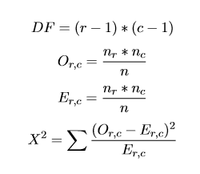
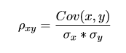
Feature Selection
Methodology
CATEGORICAL
VALUES
PRE-PROCESSED
LIST OF FEATURES
FINAL LIST OF FEATURES
Chi-Square Test
CONTINUOUS
VALUES
Correlation Test
Notes:
[Elisha] For selecting our features we’ve decided to go with utilizing the chi-square test to figure out the significant factors. This proved useful in determining factors for Dataset A but proved to be more tasking for values that are continuous whilst easy for categorical ones. For the chi-square test to work on continuous features, we had to apply the concept of binning which would let us bin values into specific ranges that would then be used as if they were categorical values in the chi-square test.
This made us now apply a different method to find significant factors for Dataset B [since the binning process for the Chi-square test for continuous values can affect the accuracy of the reading.] We would now use chi-square test on values that were categorical and would use the correlation test to values that are continuous to create more accurate readings.
For the purposes of this project we have chosen a significance level of 0.05 for the chi-square test and a significance level of 0.01 for the correlation test. Notes on the usage of equations in the manuscript: The Chi-square p-value of each feature can be computed by using Equations 4.1 to 4.4where DF is the degree of freedom,Or,cis the frequency count at level r of the first variable and level c of the second variable,Er,cis the expected frequency, and X2 is the chi-square random variable. r is the number of levels of the categorical variable (e.g. GPA) and c is the number of levels for the other categorical variable (e.g. Graduation in four, five, six years).nris the total number of samples at level r of the first variable,ncis the total number of samples at level c o f20 the second variable, n is the total number of samples. After computing for the degree of freedom and chi-square random variable, the proponents will enter the values to a Chi-square Distribution Calculator to determine the p-value

Slide 16
Feature Selection
Results and Analysis - Course Retention
No. | Feature | Data Type
1 | Entry to 1st Choice Degree Program | Categorical
2 | Entry to 2nd Choice Degree Program | Categorical
3 | High School GWA | Continuous
4 | School Type | Categorical
5 | STFAP/STS Bracket (Upon Entry) | Categorical
6 | UPCAT Score (Average T-Score) | Continuous
7 | UPCAT Score (Language Proficiency T-Score) | Continuous
8 | UPCAT Score (Math T-Score) | Continuous
9 | UPCAT Score (Science T-Score) | Continuous
10 | UPCAT Score (Reading Comprehension T-Score) | Continuous
11 | UP Predicted Grade | Continuous
12 | UP Math Predicted Grade | Continuous
Features for Course Retention Prediction
Notes:
[Elisha] Taking note of the following: Chi-square significance level: 0.05
Correlation significance level: 0.01
These would be the factors that mainly affect course retention.

Slide 17
Feature Selection
Results and Analysis - Time to Graduation
Legend | Feature | Data Type
1 | Dormer? | Categorical
2 | High School GWA | Continuous
3 | Scholarship? | Categorical
4 | UPCAT Score (Average T-Score) | Continuous
5 | UPCAT Score (Math T-Score) | Continuous
6 | UPCAT Score (Science T-Score) | Continuous
7 | UPCAT Score (Reading Comprehension T-Score) | Continuous
8 | UP Predicted Grade | Continuous
9 | UP Math Predicted Grade | Continuous
Features for Course Retention Prediction
Notes:
[Elisha] These would then be the factors that affect time to graduation, and it is interesting to note that there are more significant factors that affects a student’s stay in their course rather than their overall time to graduate.

Slide 18
Prediction Model Development
Testing
Feature Selection
Prediction Model Development
Descriptive Analysis
Notes:
[Mico]

Slide 19
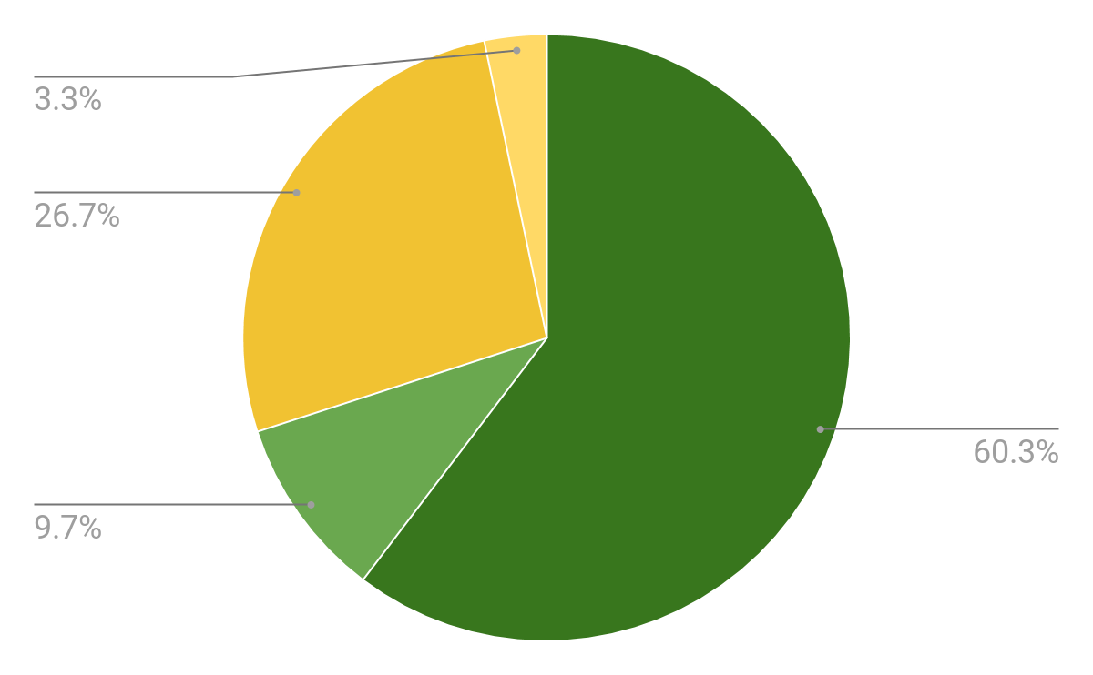
Testing
Methodology - Percentage Distribution (Course Retention)
Training and Test Sets
70-30 Split
Stratified Sampling
Graduated in Same Course
Training Set
Test Set
 | Overall | Training Set | Test Set
Yes | 87.04% | 86.16% | 89.08%
No | 12.96% | 13.84% | 10.91%
Notes:
[Mico]
After determining the features that shall serve as inputs to the prediction models, we split the data set into a 70-30 split for training and test sets, respectively. To ensure that the splits are representative of the whole data set, we used stratified sampling where the outputs “Graduated in same Course” and “Number of Years to Graduate” served as the strata. Here we can see the percentage distribution for the Graduated in Same Course output where the overall, training, and test sets approximately have the same distribution.

Slide 20
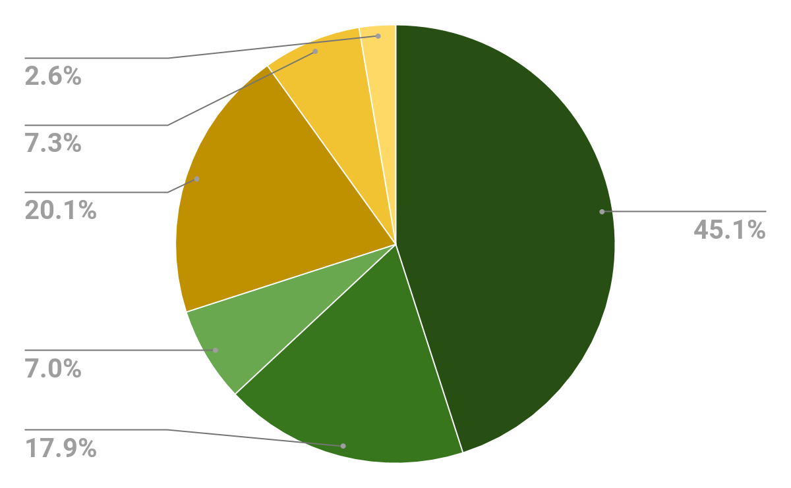
Testing
Methodology - Percentage Distribution (Time to Graduation)
Training and Test Sets
70-30 Split
Stratified Sampling
No. of Years to Graduate
Training Set
Test Set
 | Overall | Training Set | Test Set
5 | 65.16% | 64.37% | 67.02%
6 | 25.18% | 25.62% | 24.18%
7 | 9.65% | 10.02% | 8.8%
Notes:
[Mico]
Here we can also see that the percentage distribution of “Number of Years to Graduate” is also almost equal to one another. Again, this ensures that both the training and test sets are representative of the overall data set as training on data that misrepresents the overall data set could lead to a low overall accuracy.

Slide 21
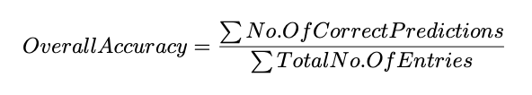
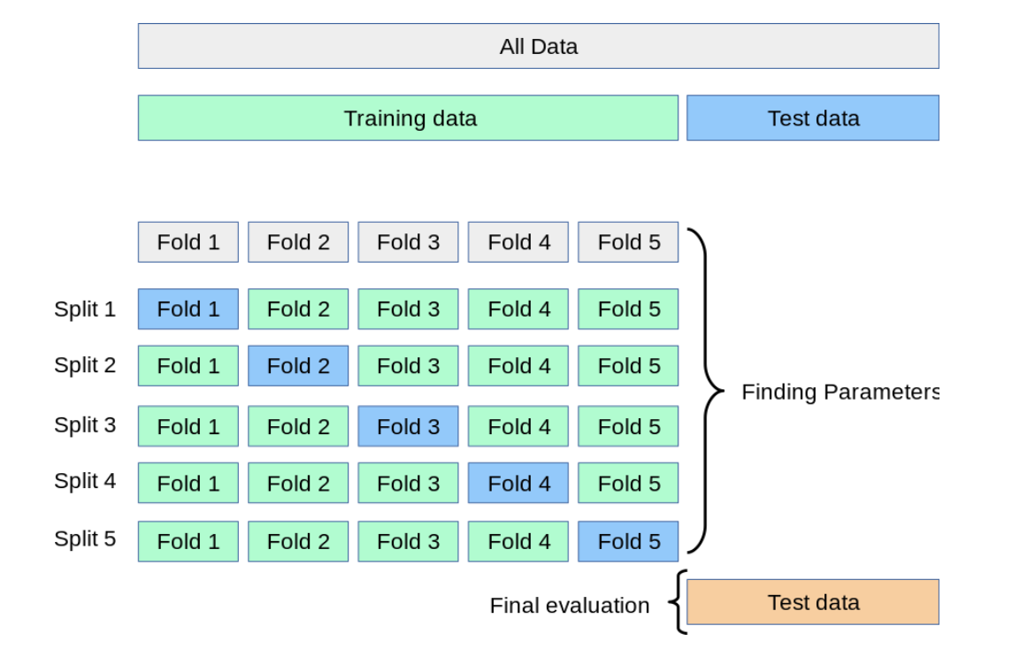
Testing
Methodology
Performance Metric
Overall Accuracy
At least 70% for all prediction models
Cross-validation: 5 Folds
Cross-validation Sample from:
https://scikit-learn.org/stable/modules/cross_validation.html
Notes:
[Mico]
To be able to evaluate the developed models, we used overall accuracy as the performance metric. We defined overall accuracy as the sum of correct predictions in the training and test sets over the total number of entries in both sets. [Simply taking the average of the accuracies of the training and test sets are not applicable as the sets have different sizes. Also, both accuracies were considered since a high difference between the two accuracies could signify that a prediction model is overfitting or underfitting.]
For all models that were developed, we aimed to achieve an overall accuracy of at least 70%. A 5-fold cross-validation was used for the development of the prediction models. [The figure shows how a 5-fold cross-validation works where the training set is split into 5 sets and trained for 5 iterations. Each fold serves as validation set for the remaining 4 sets. The average of the accuracy of the five iterations serve as the training set accuracy.]
Finally, the trained model is used on the test set which reports the test set accuracy.

Slide 22
Prediction Model Development
Decision Trees
Probabilistic Model
Support Vector Machine
Feature Selection
Prediction Model Development
Descriptive Analysis

Slide 23
Decision Trees
Methodology, Results and Analysis

Slide 24
Decision Trees
Methodology
Data Encoding
Parameter Tuning
Ordinal Encoders
Trial and Error
One hot Encoding
Grid Search
Notes:
[Regis]
The original implementation is shown here.
sklearn does not accept strings as inputs to the functions. Therefore, it is necessary to convert them into integers. The first method of doing so is using ordinal encoders. It assigns an integer value to each unique feature with no regard to its value. For example, public school would be treated as 1, private school as 2, and so on and so forth. The tuning of parameters on the other hand, was done manually, and tweaked it at every runtime. This would result in a very tedious process, and potentially too many combinations to note and find the accuracy for.
After moving to Dataset B, issues were found regarding the encoding of data. Decision trees split the data based on some arbitrary value of the feature. For example, if the decision tree were to split based on HSGWA, it would find a good point in the range of values where the split would classify the output classes of the entries. This makes sense when it comes to continuous features because there is actual meaning to their values. This is problematic on categorical features that have no relation to their integer value. For categorical features with more than two values (e.g. School type), it would pose a problem because it might group two unrelated school types together when making a split, and that will result to questionable outputs. To fix this issue, the encoding was changed from ordinal encoders to one-hot encoding. This essentially creates more features based on the number of unique entries in a feature. For example, it will create school_type_private, school_type_public, school_type_science_high_school, and so on and so forth. What it does is it just puts a 1 to its original value. If the student was from a private high school, then school_type_private will have a 1, and the rest will be 0. This will now work because the integer value means just yes or no, and the splits will be made accordingly.
To tune the parameters, grid search was used. This lets the user input a range of values for the parameters, and it will try each combination and check which one has the highest accuracy. The best parameters for each model are as follows.

Slide 25
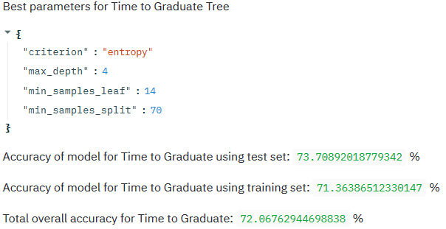
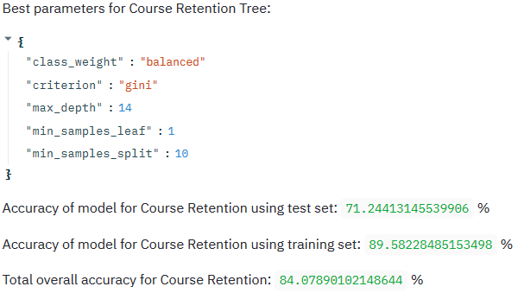
Decision Trees
Methodology - Revised
Time to Graduate Model
Course Retention Model
Notes:
[Regis]
The overall accuracy of the time to graduate model is 72.06%, while the overall accuracy of the course retention model is 84.07%. The course retention model has an extra parameter compared to the time to graduate model, and this is because there was a problem with the model without it. There is a disproportionate amount of ‘Yes’ in the training set compared to the ‘No’ class, where there are 1712 entries with ‘Yes’ compared to the 275 ‘No’ entries. This created a heavy bias towards ‘Yes’, and in turn just predicted ‘Yes’ for every single test entry. Although it had an accuracy of over 80%, this was not a good model because it just happened that most of the test set and training set had significantly more ‘Yes’ classes than ‘No’ classes. To fix this issue, I added the parameter ‘class_weight’. It gives the smaller ‘No’ class a heavier weight when training the model, and thus it was able to predict ‘No’ classes with still a relatively high accuracy. It was set to balanced to automatically set the weight depending on the training set.

Slide 26
Decision Trees
Results and Analysis - Confusion Matrix
 | Predicted
Expected | 5 | 6 | 7 | Total
5 | 1222 | 57 | 0 | 1279
6 | 313 | 196 | 0 | 509
7 | 194 | 5 | 0 | 199
Total | 1729 | 258 | 0 | 1987
 | Predicted
Expected | 5 | 6 | 7 | Total
5 | 547 | 24 | 0 | 571
6 | 125 | 81 | 0 | 206
7 | 72 | 3 | 0 | 75
Total | 744 | 108 | 0 | 852
Confusion Matrix of Training Set for Time to Graduate
Confusion Matrix of Test Set for Time to Graduate
Notes:
[Regis]
These are the confusion matrices for the time to graduation model for both training set and test set. Here it can be seen that the model did not predict any ‘7-year’ classes for both cases. Again, this is because of the rare cases of ‘7-years’ in the training set, thus results in the model only predicting the ‘5-year’ and ‘6-year’ class. Despite this, there is still a high number of correct predictions for the ‘5-year’ and ‘6-year’ classes, so no further tweaking was done. Since most of the data is dominated by these two classes, the model balancing was left as is.

Slide 27
Decision Trees
Results and Analysis - Confusion Matrix
 | Predicted
Expected | ‘Yes’ | ‘No’ | Total
‘Yes’ | 1509 | 203 | 1712
‘No’ | 6 | 269 | 275
Total | 1515 | 472 | 1987
 | Predicted
Expected | ‘Yes’ | ‘No’ | Total
‘Yes’ | 587 | 172 | 759
‘No’ | 63 | 30 | 93
Total | 650 | 202 | 852
Confusion Matrix of Training Set for Course Retention
Confusion Matrix of Test Set for Course Retention
Notes:
[Regis]
Comparing the number of predicted ‘Yes’ and ‘No’ classes with the actual ‘Yes’ and ‘No’ classes, it can be seen that there is a significantly higher number of ‘No’ predictions compared to the actual data. This is due to the class_weight balancing done in the previous iteration of this model. It put a larger weight on the ‘No’ classes, so more value has been given to the lesser number of classes. With this fix, the model is now able to predict ‘No’ classes, and there is still a significant amount of correct predictions.

Slide 28
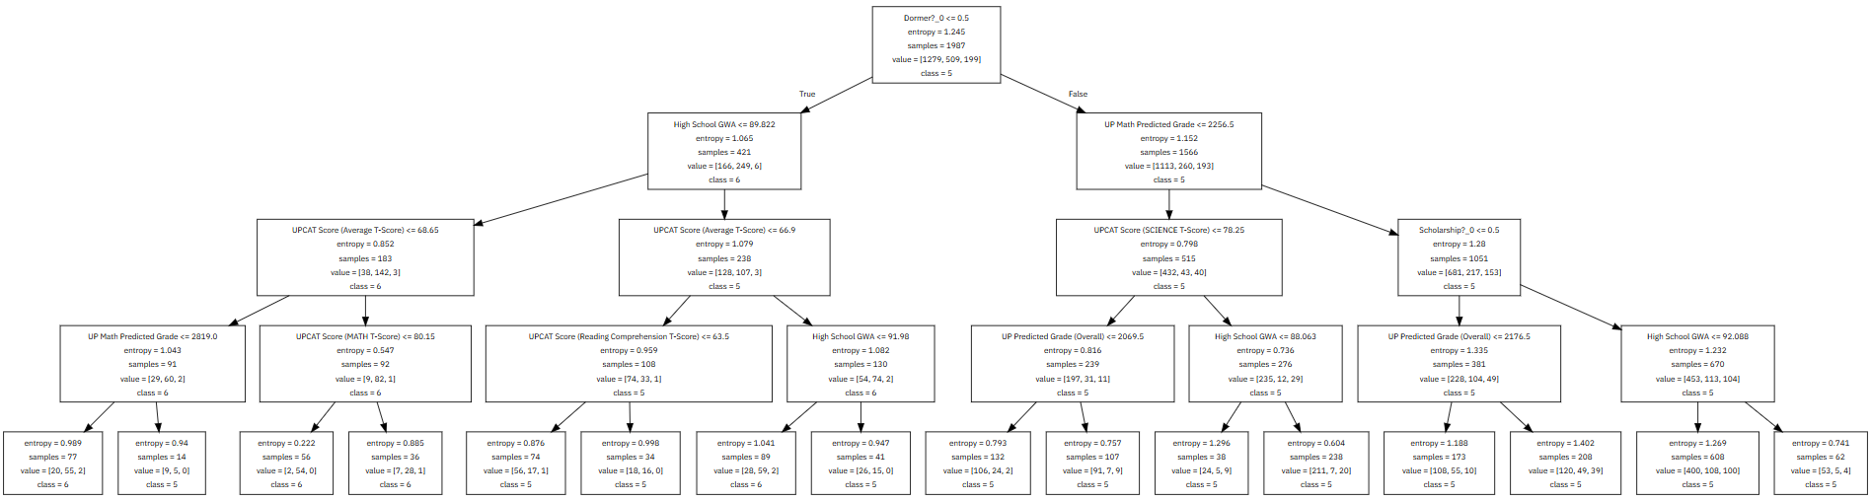
Decision Trees
Results and Analysis - Tree
Notes:
[Regis]
The decision tree is read in such a manner that there is a specific condition being checked before the split. If it fulfills the condition, it goes to the right, signifying true, and if false, it splits to the left.
This is the Decision tree that the time to graduate model has generated. It can be seen in the root node that the basis of the first split depends on being a dormer or not. From here, the tree has already made a split that if you are a dormer, the majority of them have graduated in 5 years, while not being a dormer classifies you as the 6 years to graduate. There are further splits, but most of them start to rely on your performance in the UPCAT. (skip) There is only one node where it checks for scholarship, and that is in the third level where all conditions are not met. Note that is it possible for Decision Trees to not use all the features as it may deem some features unnecessary in classifying the data.

Slide 29
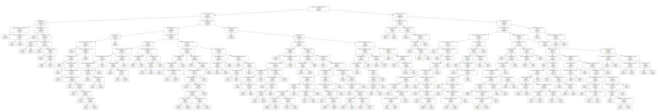
Decision Trees
Results and Analysis - Tree
Notes:
[Regis]
Here is the Decision Tree for the Course Retention Model. It can be seen that there are many levels to this tree, which makes it a bit complicated to analyze. In cases like these, it may be a bit tedious to go through each node one by one by hand. This is the tree that the model generated because it may have had a hard time classifying the data with just a few number of splits, therefore creating this many. Manually changing the parameters, it would either give a tree this large or a tree so small that it makes all the other features unnecessary. The latter gave a lower accuracy, and it doesn’t make sense to just base someone’s course retention with just two features.

Slide 30
Probabilistic Model
Methodology, Results and Analysis

Slide 31
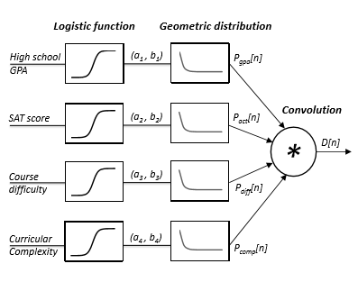
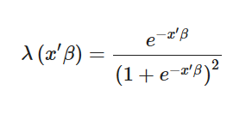
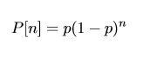
Probabilistic Model
Methodology - Initial Model
Logistic function:
Based on:
[3] A. Slim, G.L. Heileman, M. Hickman, and C.T. Abdallah. A geometric distributed probabilis-
tic model to predict graduation rates. In
2017 IEEE SmartWorld, Ubiquitous Intelligence &
Computing, Advanced & Trusted Computed, Scalable Computing & Communications, Cloud
& Big Data Computing, Internet of People and Smart City Innovation
Geometric distribution function:
Notes:
[Elisha] Initially the probabilistic model would feature this method, where each factor would be placed into a logistic regression function then resolve a probability. This probability would be the odds of students graduating on time or not or retaining in their course or not. For the purpose of this model we would also want to view the probability of knowing the odds of how many years it will take before a student graduates and for that we introduce the geometric distribution. Finally we convolve all the inputs to give an overall reading.

Slide 32
Probabilistic Model
Methodology - Revised Model
Selected Features
Multinominal Logistic Regression
Predictions and Probabilities
Notes:
[Elisha] During the course of the project, I discovered that there is a more efficient method to achieve the probabilistic model. Instead of passing the inputs into 2 functions (Logistic Regression and Geometric Distribution), we would only need to use 1 function, the multinominal logistic regression, this functions like the logistic regression earlier but instead of only giving binary outputs it can now predict more than 2 results. So after implementing the new model we would get results seen in the next slide.

Slide 33
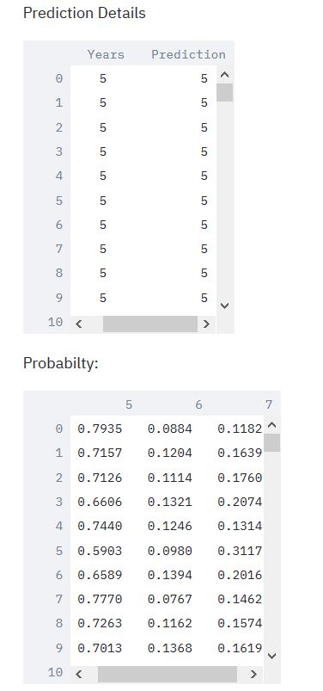
Probabilistic Model
Results and Analysis - Output
Notes:
[Elisha] The model’s outputs would look like so where we it calculates the all probabilities of a student graduating in 5,6,7 years. It then takes the highest percentage prediction as the prediction output. This method would initially yield an accuracy below 60% so different methods were used to improve the accuracy.

Slide 34
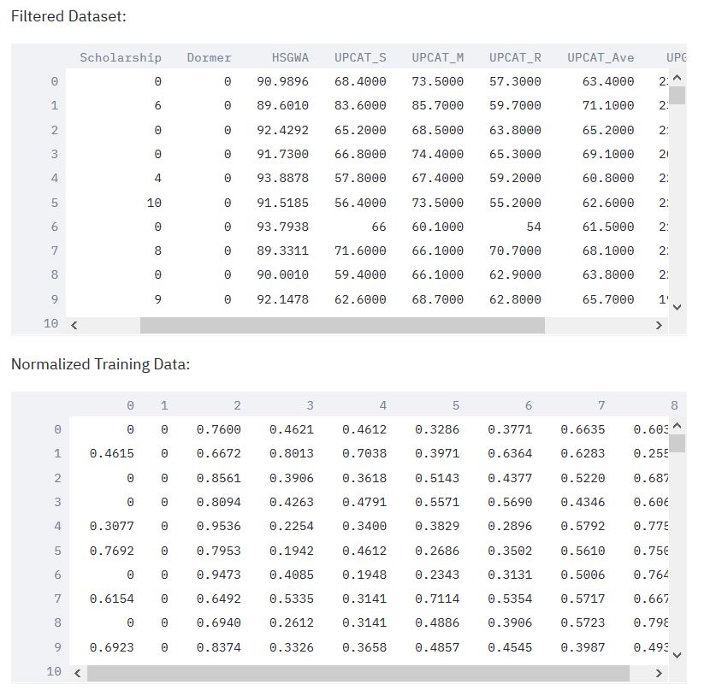
Probabilistic Model
Methodology - Accuracy Improvement
Normalization of Inputs
Minmaxscaler of from 0 to 1
Notes:
[Elisha] First, would be normalizing the dataset. To better improve the accuracy of a probabilistic model, one way is to smooth its input. Since the output of logistic regression would be a positive probability from 0 to 1, it would be more helpful for the function if the dataset was normalized from 0 to 1. So the best normalization method that gave the highest accuracy was using Scipy’s minmaxscaler ranging from values 0 to 1.

Slide 35
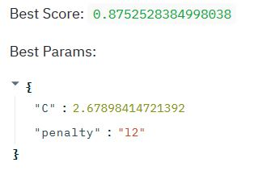
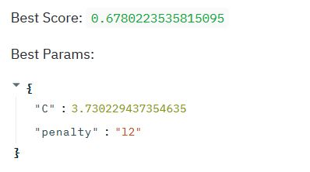
Probabilistic Model
Methodology - Accuracy Improvement
Hyperparameter Tuning
C
Penalty
Parameters for Course Retention
Parameters for Time to Graduate
Notes:
[Elisha] To further improve accuracy, I have opted to tinker with the Logistic Regression’s hyperparameters using Grid Search and Random Search, in which Random Search gave better accuracy readings. Even after changing the function’s parameters and normalization, there is only a maximum accuracy that could be found for the probabilistic model. As we can see for Time to Graduate, the best accuracy reading for the test set would be 67% but after using the model the actual test set accuracy would be 64%, which in turn affects the overall accuracy to 69%, which will be seen at the model comparison slide. This is the maximum accuracy that the probabilistic model can reach because the model is dependent on the smoothness of the model.

Slide 36
Probabilistic Model
Results and Analysis - Confusion Matrices
Training Set
Test Set
 | Predicted
Expected | ‘Yes’ | ‘No’ | Total
‘Yes’ | 1739 | 0 | 1739
‘No’ | 249 | 0 | 249
Total | 1988 | 0 | 1988
 | Predicted
Expected | ‘Yes’ | ‘No’ | Total
‘Yes’ | 731 | 1 | 732
‘No’ | 118 | 1 | 119
Total | 849 | 2 | 851
 | Predicted
Expected | 5 | 6 | 7 | Total
5 | 1226 | 123 | 0 | 1349
6 | 248 | 206 | 0 | 454
7 | 177 | 8 | 0 | 185
Total | 1651 | 337 | 0 | 1988
 | Predicted
Expected | 5 | 6 | 7 | Total
5 | 456 | 45 | 0 | 501
6 | 163 | 97 | 1 | 261
7 | 86 | 3 | 0 | 89
Total | 705 | 145 | 1 | 851
Notes:
[Elisha] Moving the confusion matrices of the probabilistic model, it can be seen that the overall predictions are inclined to specific outputs (i.e Yes rather than No, and more inclined to predict 5 or 6 years rather than including 7). This shows that the model is difficult if it will only output an overall prediction and would be more beneficial if looked with the probabilities.

Slide 37
Support Vector Machine
Methodology, Results and Analysis

Slide 38
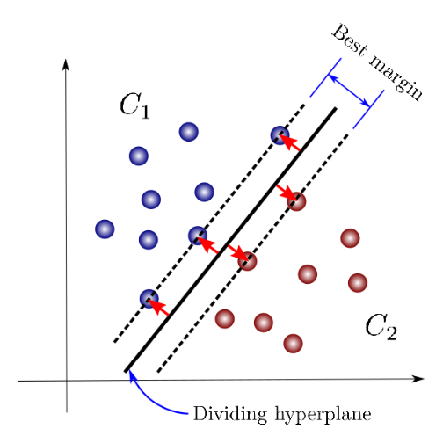
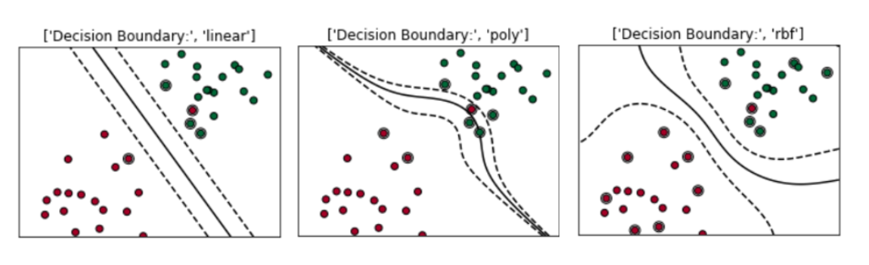
Support Vector Machine
Methodology - Technical Implementation
SVM Hyperparameters
Kernel
C
Gamma
Images from:
SVM Sample: https://towardsdatascience.com/support-vector-machines-for-classification-fc7c1565e3
Notes:
[Mico]
To fine tune the SVM and increase the accuracy of the model, we will adjust the following hyperparameters:
Kernel
C
Gamma
[
The kernel dictates what the input or the dataset will be transformed to.
Some of the kernels in SVM are linear which forms a straight hyperplane,
Polynomial which forms a curved hyperplane,
and radial basis function where the hyperplane encapsulates the different data points.
C serves as the regularization parameter of SVM.
A larger C would tolerate a smaller margin between the hyperplane and the support vectors if it would result to a higher model accuracy,
while a lower C would trade-off model accuracy for a wider margin.
Gamma meanwhile dictates how much influence a support vector has over the hyperplane.
A gamma that’s too high would only include the data point itself
while a gamma that’s too low would result to a model that is not complex enough to accurately classify the data.]

Slide 39
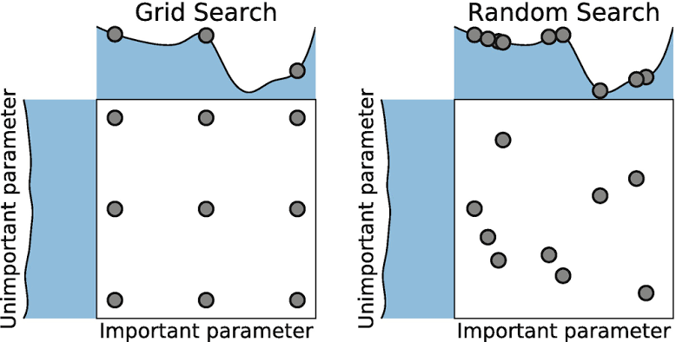
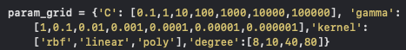
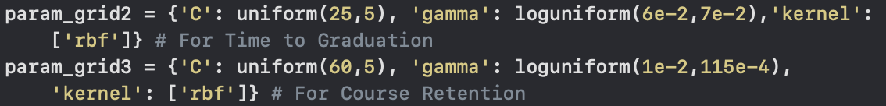
Support Vector Machine
Methodology - Technical Implementation
Accuracy Improvement
Dataset Alteration
Non-numerical Conversion
Scaling
Resampling
Hyperparameter Tuners
Grid Search
Random Search
Images from:
Grid Search and Random Search: https://miro.medium.com/max/2008/0*yDmmJmvRowl0cSN8.png
Notes:
[Mico]
Since there are features in the training and test set that contain non-numerical values, these were converted to numerical values using scikit’s OrdinalEncoder() for bi-categorical values (e.g. Scholarship?) and Pandas’ get_dummies for multi-categorical values (e.g. STFAP/STS Bracket).
To improve the accuracy, I standardized the features using scikit’s StandardScaler() function since the features have different scales (e.g. UPG ranges from 0-5000 while HSGWA ranges from 0-100).] Lastly, resampling is explored if the developed model is heavily biased towards one class.
To aid in finding the optimal values for these hyperparameters, tuners such as grid search and random search will be explored. These tuners simply create multiple models with different hyperparameters from a preset list.
[Grid search finds every possible combination while random search randomly comes up with a combination for n number of times that the user has inputted. For the development of the SVM models, grid_search was used initially to find the best hyperparameter values among a large range of parameters (as seen in param_grid). After determining the initial best hyperparameter values, random_search was used iteratively where each training iteration has a smaller range of parameters.]

Slide 40
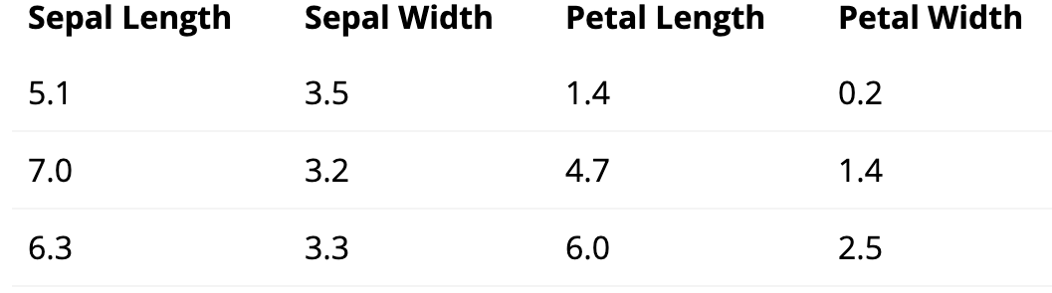
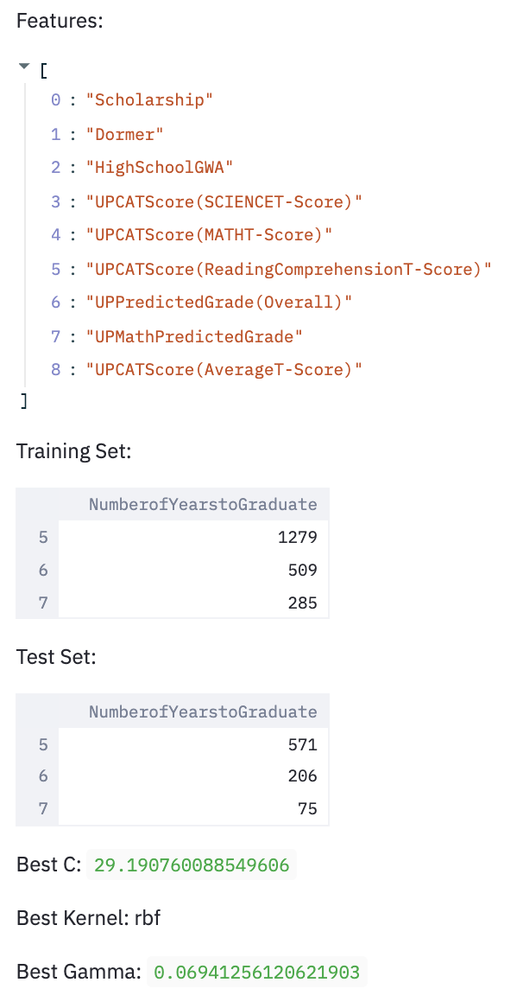
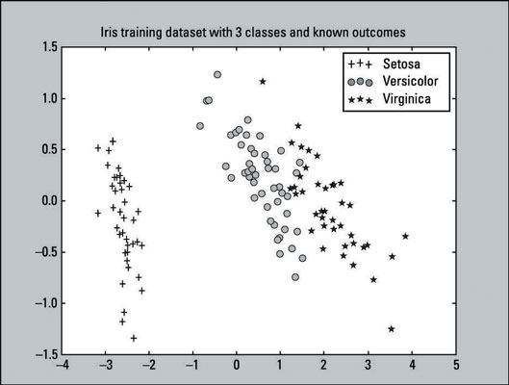
Support Vector Machine
Methodology - Technical Implementation
Plotting
Principal Component Analysis
Interface
Streamlit
Images from:
PCA Sample: https://www.dummies.com/programming/big-data/data-science
/how-to-visualize-the-classifier-in-an-svm-supervised-learning-model/
Notes:
[Mico]
The feature set contained multiple features thus plotting the two-dimensional (2D) representation of the data set is not as simple as getting their x-y values. Principal Component Analysis (PCA) was used to transform the data set so that they may be represented in 2D.
PCA works by generating a new list of features that are based on the combination of the initial list of features then ranks them by significance. Reducing the dimensions of the data set is then just a matter of dropping the low-ranking new features. From this, a 2D representation of the data set and the decision boundaries can be plotted.
Lastly, Streamlit was used to create the interface of training the SVM models. It displays the features that are selected for the model, the number of entries, the best hyperparameters, confusion matrices, and accuracies.

Slide 41
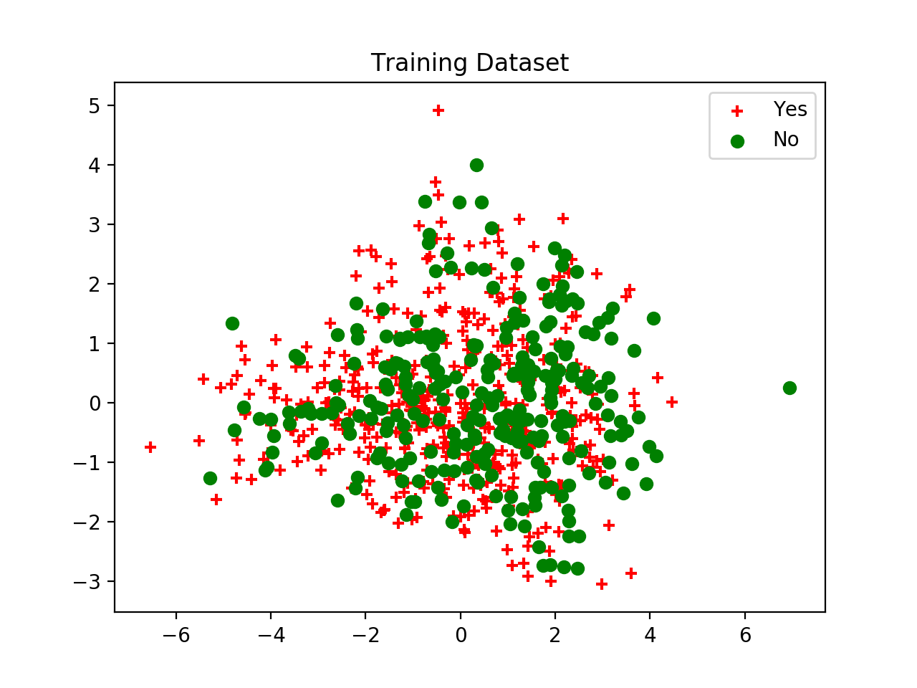
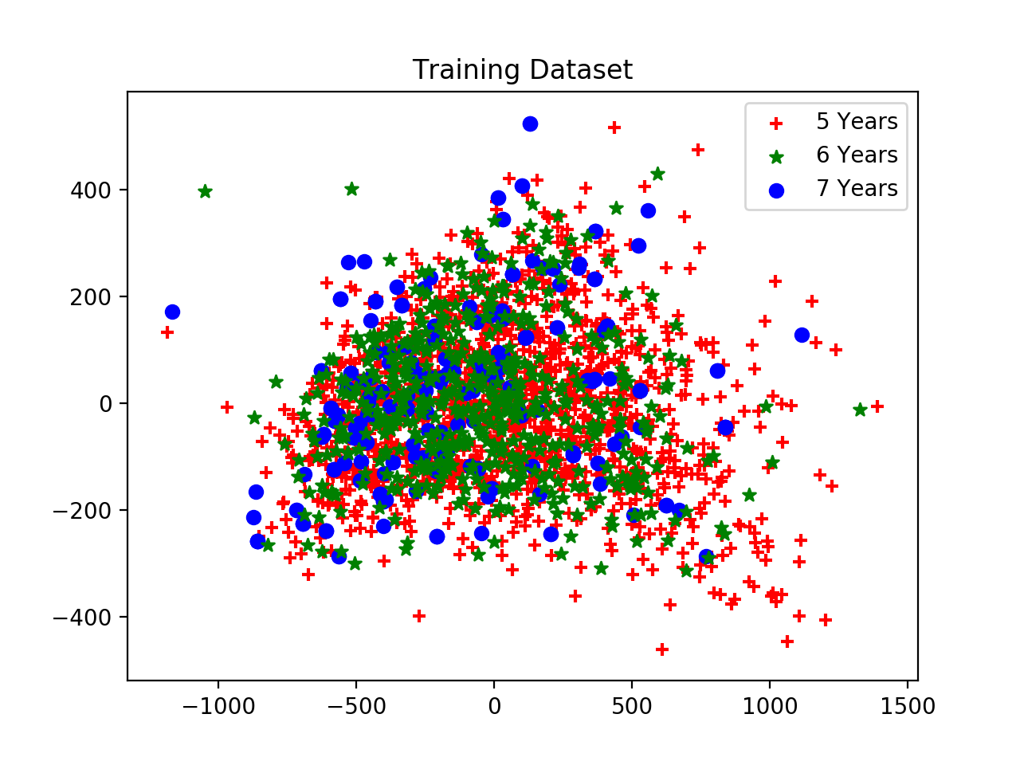
Support Vector Machine
Results and Analysis - Accuracy Improvement
Two-dimensional Representation of Training Sets of
Course Retention and Time to Graduation
Notes:
[Mico]
Seen here are the 2D representation of the training sets of Course Retention prediction and Time to Graduation prediction. As most of the data points are clumped together and are almost homogenous, the linear and poly kernel are not suitable for the data set. This limited the options to rbf and sigmoid where after preliminary tests, the rbf kernel proved to be more accurate.

Slide 42
Support Vector Machine
Results and Analysis - Course Retention Prediction
 | Predicted
Expected | ‘No’ | ‘Yes’ | Total
‘No’ | 0 | 275 | 275
‘Yes’ | 0 | 1712 | 1712
Total | 0 | 1987 | 1987
 | Predicted
Expected | ‘No’ | ‘Yes’ | Total
‘No’ | 0 | 93 | 93
‘Yes’ | 0 | 759 | 759
Total | 0 | 852 | 852
Hyperparameters
Kernel: rbf
C: 1261.98
Gamma: 189.18
Initial Model Confusion Matrices of Training Set and Test Set
 | Training | Test | Overall
‘No’ | 0% | 0% | 0%
‘Yes’ | 100% | 100% | 100%
Set | 86.16% | 89.08% | 87.04%
Initial Model Accuracies
Notes:
[Mico]
The initial model for Course Retention prediction had an overall accuracy of 87.04%, but it was very biased towards the ‘Yes’ class. This also explains why it has a high accuracy since the data sets are dominated by the ‘Yes’ class.
As seen in the confusion matrices, the model was not able to predict the ‘No’ class at all and predicted them as ‘Yes’ leading to a ‘No’ class accuracy of 0%. Based on related works studied, this may be due to an imbalanced data set and thus I resampled the training set to minimize the number of data points for the ‘Yes’ class.

Slide 43
Support Vector Machine
Results and Analysis - Course Retention Prediction
 | Predicted
Expected | ‘No’ | ‘Yes’ | Total
‘No’ | 127 | 148 | 275
‘Yes’ | 36 | 414 | 450
Total | 163 | 562 | 725
 | Predicted
Expected | ‘No’ | ‘Yes’ | Total
‘No’ | 34 | 59 | 93
‘Yes’ | 160 | 599 | 759
Total | 194 | 658 | 852
Hyperparameters
Kernel: rbf
C: 62.93
Gamma: 0.0113
Final Model Confusion Matrices of Training Set and Test Set
 | Training | Test | Overall
‘No’ | 46.18% | 36.56% | 43.75%
‘Yes’ | 92.00% | 78.92% | 83.79%
Set | 74.62% | 74.30% | 74.45%
Final Model Accuracies
Notes:
[Mico]
Resampling the data set lowered the overall accuracy of the model to 74.45%, but increased the per-class accuracy of the ‘No’ class. Moreover, the hyperparameter values are also notably lower than the initial model which might also explain why the initial model was having a hard time encapsulating the ‘No’ class.
While this model has a lower overall accuracy, one must remember that the initial model only had a higher accuracy because it was biased towards the ‘Yes’ class which composed majority of the training and test sets.
For the purpose of the project, which is to model the graduation and retention rates of engineering students, it is more beneficial to have a model that could predict both classes as we want to identify those who are at risk or those who are at the ‘No’ class. Thus, this model is considered as the final Course Retention SVM model despite having a lower accuracy.
From here, a 2D representation of the hyperplane or decision boundaries was created to clarify why we can’t improve the model further. The 2D representation has the same C and kernel as the developed model, but gamma was adjusted until the accuracy is similar to that of the developed model.

Slide 44
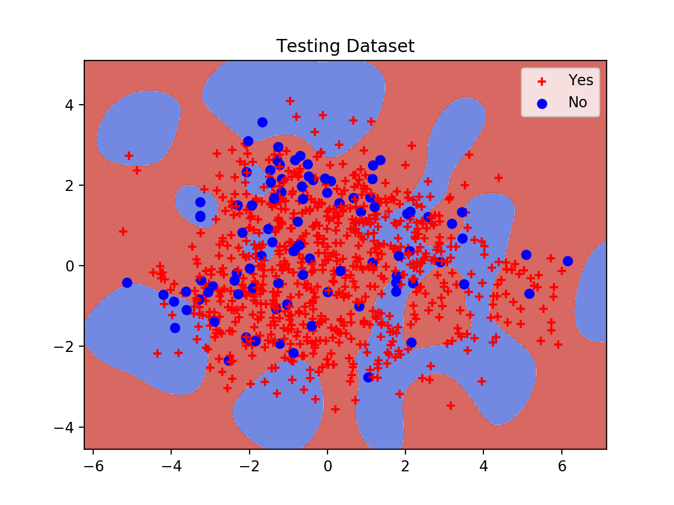
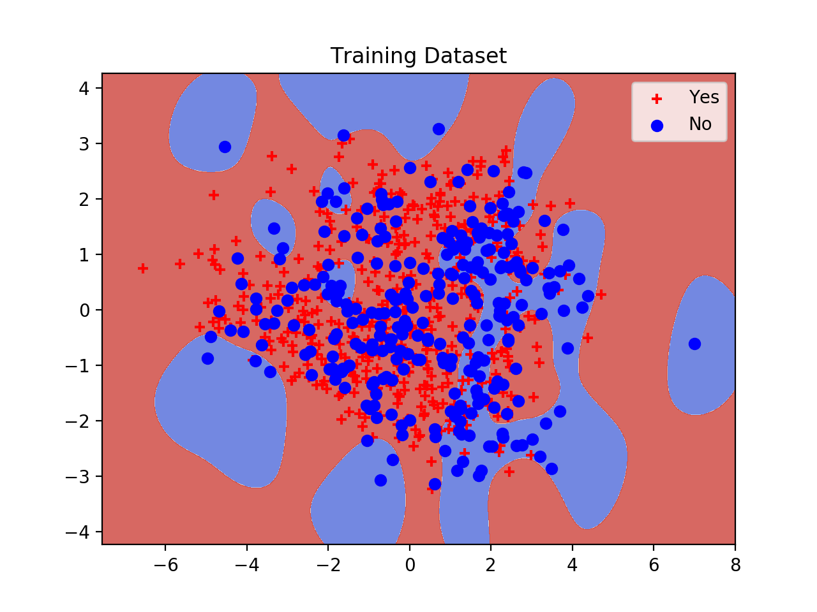
Support Vector Machine
Results and Analysis - Course Retention Prediction
Training Set and Test Set
Decision Boundaries
Notes:
[Mico]
Here we can see the theoretical decision boundaries of the Course Retention model seen in the previous slide. While the model can easily encapsulate the ‘Yes’ class, it has a hard time of encapsulating the ‘No’ class as it is too close to the ‘Yes’ data points. This tells us while the imbalance of data points was a factor for model bias, the model could further be improved by having additional features that would make the differences between the classes more discernible.

Slide 45
Support Vector Machine
Results and Analysis - Initial Model (Time to Graduation)
 | Predicted
Expected | 5 | 6 | 7 | Total
5 | 1265 | 84 | 0 | 1349
6 | 259 | 195 | 0 | 454
7 | 180 | 5 | 0 | 185
Total | 1704 | 284 | 0 | 1988
 | Predicted
Expected | 5 | 6 | 7 | Total
5 | 472 | 29 | 0 | 501
6 | 161 | 100 | 0 | 261
7 | 86 | 3 | 0 | 89
Total | 719 | 132 | 0 | 851
Hyperparameters
Kernel: rbf
C: 22.098
Gamma: 0.009
Initial Model Confusion Matrices of Training Set and Test Set
 | Training | Test | Overall
5 | 93.77% | 94.21% | 93.89%
6 | 42.95% | 38.31% | 41.26%
7 | 0.00% | 0.00% | 0.00%
Set | 73.44% | 67.21% | 71.57%
Initial Model Accuracies
Notes:
[Mico]
Similar to the initial course retention model, the initial Time to Graduation model was also able to surpass the minimum 70% accuracy at 71.57%. However, the same problem can be seen where the model was unable to predict the ‘7 Years’ minority class.
Again, to alleviate the problem, the training set was resampled. This time, instead of just reducing the ‘5 Years’ class, the ‘6 Years’ and ‘7 Years’ classes were also increased.

Slide 46
Support Vector Machine
Results and Analysis - Final Model (Time to Graduation)
 | Predicted
Expected | 5 | 6 | 7 | Total
5 | 1214 | 57 | 8 | 1279
6 | 275 | 230 | 4 | 509
7 | 216 | 1 | 68 | 285
Total | 1705 | 288 | 80 | 2073
 | Predicted
Expected | 5 | 6 | 7 | Total
5 | 533 | 27 | 11 | 571
6 | 123 | 80 | 3 | 206
7 | 63 | 4 | 8 | 75
Total | 719 | 111 | 22 | 852
Hyperparameters
Kernel: rbf
C: 29.19
Gamma: 0.069
Final Model Confusion Matrices of Training Set and Test Set
 | Training | Test | Overall
5 | 94.92% | 93.35% | 94.43%
6 | 45.19% | 38.83% | 43.36%
7 | 23.86% | 10.67% | 21.11%
Set | 72.94% | 72.89% | 72.92%
Final Model Accuracies
Notes:
[Mico]
After resampling the training set, the model is now able to predict the ‘7 years’ class and it increased the overall accuracy and per-class accuracies. The overall accuracy is now at 72.92%.
In terms of hyperparameter values, there is not much of a notable difference from the initial model which might tell us that the imbalance dataset is the leading factor of the biased predictions in the initial model.
This is considered as the final Time to Graduation SVM model as it is more in line with the purpose of the project and it has a higher overall accuracy than the initial model. A 2D representation of the theoretical decision boundaries can be seen in the following slide.

Slide 47
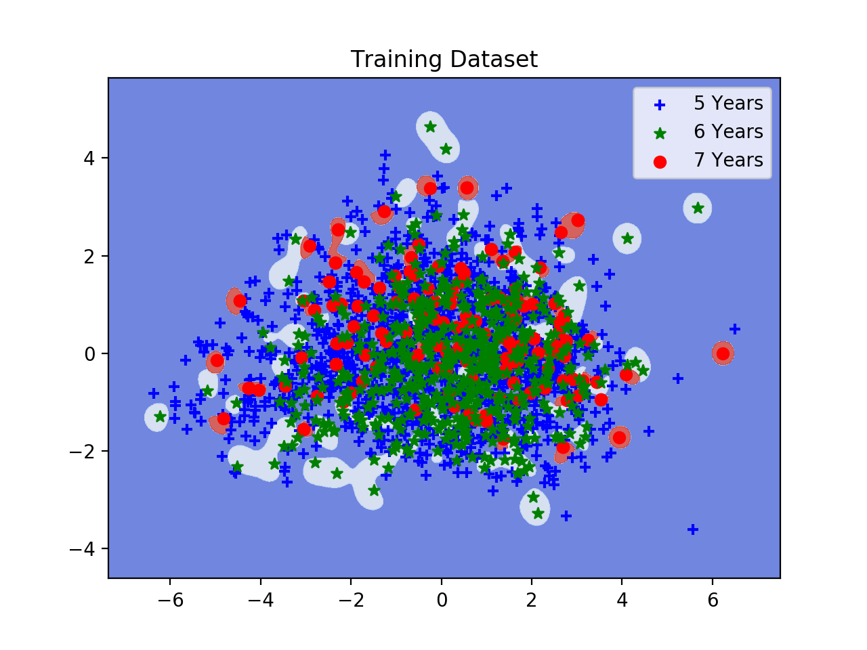
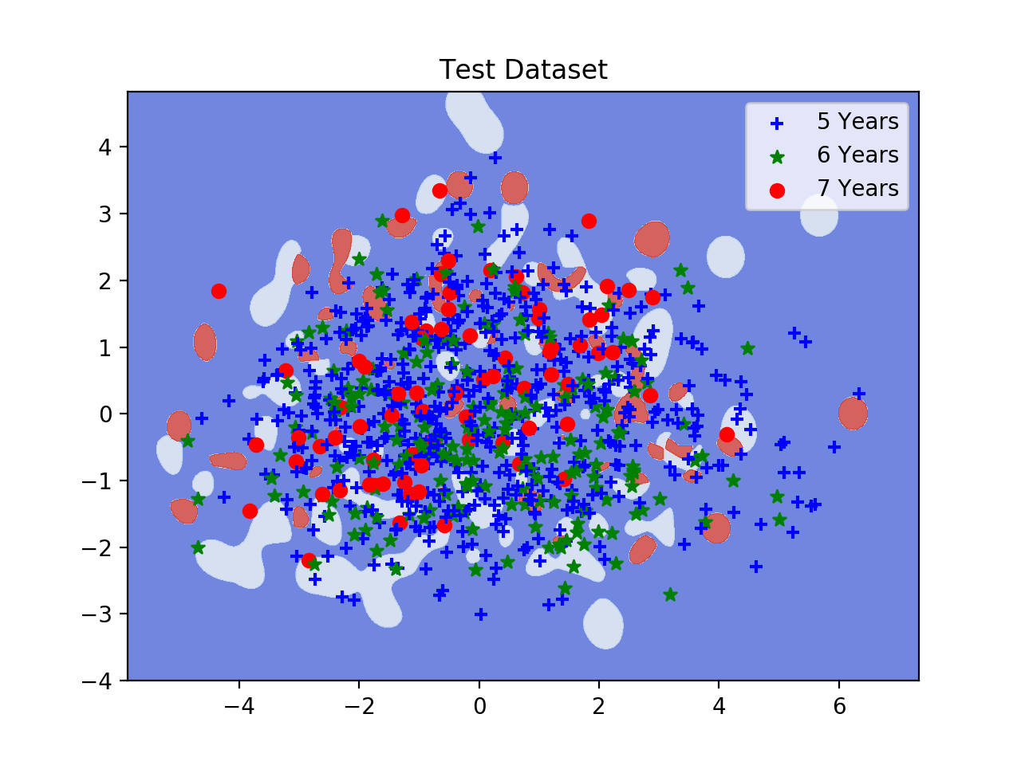
Support Vector Machine
Results and Analysis - Time to Graduation
Training Set and Test Set
Decision Boundaries
Notes:
[Mico]
Similar to the issue in the Course Retention prediction model, we can see that the model is unable to discern the different classes due to them being too close to one another. Again, this shows that the accuracy of the model could be improved further by introducing features that would it easier for the model to separate them with a hyperplane.

Slide 48
Comparison of Models
Course Retention Prediction
& Time to Graduation Prediction

Slide 49
Comparison of Prediction Models
Course Retention Prediction
 | Decision Trees | Probabilistic Model | Support Vector Machine
Training Accuracy | 89.58% | 87.47% | 74.62%
Test Accuracy | 71.24% | 86.01% | 74.30%
Overall Accuracy | 84.07% | 87.00% | 74.45%
Outputs | Yes & No | Yes | Yes & No
Notes:
[Mico]
For course retention prediction, all models were able to exceed the required minimum 70% overall accuracy.
In terms of accuracy, the ranking of the models from highest to lowest are: Probabilistic Model, Decision Trees, then Support Vector Machine.
The training and test set accuracies of both the PM, SVM model have a relatively low difference, while for DT, they have a difference of 18.34%.
While the overall accuracy of the PM model is the highest, this is due to the model being only able to predict the ’Yes’ class which dominates the training and test sets. Both the DT and SVM model can predict the ’Yes’ and ’No’ classes.

Slide 50
Comparison of Prediction Models
Time to Graduation Prediction
 | Decision Trees | Probabilistic Model | Support Vector Machine
Training Accuracy | 71.36% | 72.03% | 72.94%
Test Accuracy | 73.71% | 64.98% | 72.89%
Overall Accuracy | 72.07% | 69.88% | 72.92%
Outputs | 5 Years & 6 Years |  | 5 Years, 6 Years, & 7 Years
Notes:
[Mico]
For the Time to Graduation prediction models, the Probabilistic Model was unable to reach the minimum 70% overall accuracy required.
Here, SVM and PM have the highest and lowest overall accuracies, respectively.
All three models have a low difference between the training and test set accuracies with PM having the highest of the three at 7.05%.
Only the SVM model can predict the multi-class outputs: 5 years, 6 years, and 7 years, while the Decision Trees and Probabilistic model can predict the 5 years and 6 years classes.

Slide 51
Descriptive Analysis
Methodology, Results and Analysis
Feature Selection
Prediction Model Development
Descriptive Analysis

Slide 52
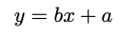
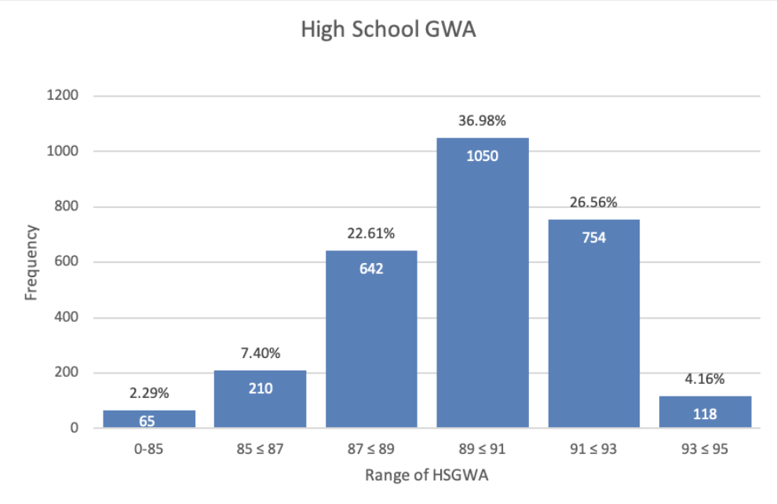
Descriptive Analysis
Methodology
Descriptive Statistics
Mean
Standard Error
Median
Mode
Standard Deviation
Skewness
Range
Minimum
Maximum
Count
Regression
Multiple R
R Square
Standard Error
Significance F
Slope Intercept Form
Histogram
Notes:
[Mico]
Using Microsoft Excel’s Analysis ToolPak add-on, we generated descriptive and regression statistics. The descriptive statistics were used to get an overview of the overall data, and were used to determine the bins needed for the charts.
[Regression uses the slope-intercept form to determine whether y, the dependent variable, is independent of x while the regression line is denoted by b. Multiple R denotes the relationship of x and y, R Square indicates how dependent y is on x, standard error measures the average distance of the data from the generated regression line, and significance F indicates the significance of to y where a values of less than 0.05 is considered significant.]
Since these functions need numerical values as inputs, categorical features that have bi-categorical values were converted to 0 or 1. Meanwhile, histograms were used for the analysis of categorical features that have multi-categorical values.

Slide 53
Descriptive Analysis
Results and Analysis - College
 | A | B | C | D
Mean | 0.66 | 0.54 | 0.51 | 0.102
Std. Error | 0.01 | 0.02 | 0.01 | 0.006
Median | 1.00 | 1.00 | 1.00 | 0.00
Mode | 1.00 | 1.00 | 1.00 | 0.00
Std. Dev. | 0.47 | 0.50 | 0.50 | 0.3
Skewness | -0.66 | 0.25 | -0.06 | 2.62
Range | 1.00 | 1.00 | 1.00 | 1.00
Minimum | 0.00 | 0.00 | 0 | 0.00
Maximum | 1.00 | 1.00 | 1.00 | 1.00
Count | 2839 | 974 | 2834 | 2834
Summary Statistics of Categorical Features with Bi-categorical Values
Notes:
[Regis]
The features have been assigned to letters to make it easier to read. The assignments are as follows.
A - Entry to 1st Degree Program
B - Entry to 2nd Degree Program
C - Scholarship
D - Dormer
Features A and B tell us that 66% of students who entered the college as freshmen got accepted into their first choice, while 54% of those not admitted to their first choice got into their 2nd choice. Feature C says that the average HSGWA of these students are around 89.81. These grades have already been converted from their respective grading system. Also it is worth noting that the lowest HSGWA of a student who was admitted into UP is 79.61.

Slide 54
Descriptive Analysis
Results and Analysis - College
 | A | B | C | D | E | F | G | H
Mean | 89.81 | 68.15 | 64.12 | 73.27 | 71.47 | 63.74 | 2.17 | 2.42
Std. Error | 0.04 | 0.08 | 0.01 | 0.16 | 0.15 | 0.10 | 3.81 | 7.18
Median | 89.99 | 67.9 | 64.2 | 73.40 | 71.40 | 63.80 | 2.19 | 2.43
Mode | 88.96 | 64.5 | 62.6 | 72.00 | 68.60 | 63.80 | 2.32 | 2.67
Std. Dev. | 2.08 | 4.49 | 5.32 | 8.44 | 7.92 | 5.36 | 0.203 | 0.383
Skewness | -0.54 | .24 | -0.32 | -0.01 | -0.02 | -0.20 | -0.73 | -0.2
Range | 14.97 | 32.4 | 38.9 | 51.20 | 45.90 | 39.30 | 1.59 | 2.33
Minimum | 79.61 | 50.00 | 40.20 | 49.40 | 47.00 | 41.5 | 2.93 | 3.47
Maximum | 94.58 | 82.4 | 79.1 | 100.6 | 92.9 | 80.8 | 1.33 | 1.14
Count | 2839 | 2839 | 2839 | 2839 | 2839 | 2839 | 2839 | 2839
Summary Statistics of Continuous Features
Notes:
[Regis]
For the other features, these are the assignments.
A - High School GWA
B - UP Average T-Score
C - UP Language Proficiency T-Score
D - UP Math T-Score
E - UP Science T-Score
F - UP Reading Comprehension T-Score
G - UP Predicted Grade
H - UP Math Predicted Grade
Features F through J display the statistics of all the UPCAT test scores of these students, while Features K and L show what UP predicts the student’s grades to be, from the scores they obtained in the UPCAT. Feature M shows that around 51% of students have had a scholarship for at least one sem in their college stay, while Feature N shows that only 10% of students have stayed in a residence hall for their stay in college.

Slide 55
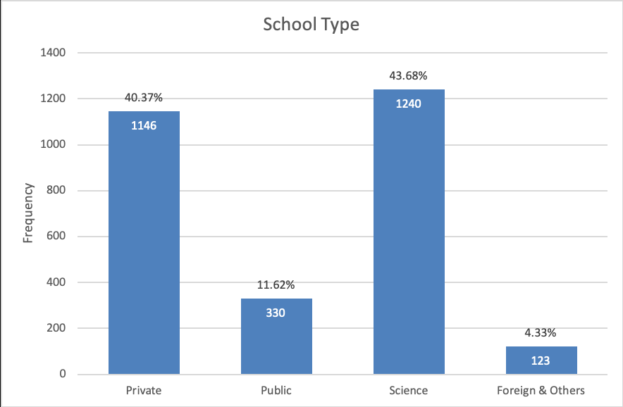
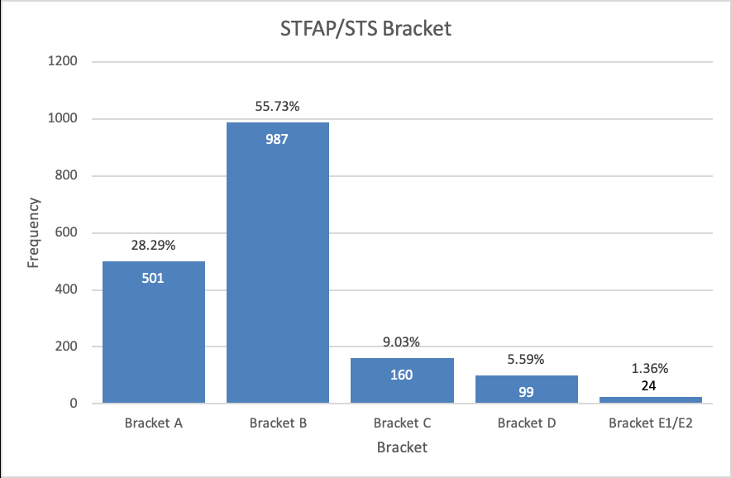
Descriptive Analysis
Results and Analysis - College
Histogram of School Type
Histogram of STFAP/STS Bracket
Notes:
[Regis]
The first graph on the right shows the histogram of the students with respect to School Type. Here it can be seen that the majority of freshmen who enter the college come from a Science High School (43.68%), followed by Private high schools (40.37%). The public schools along with the foreign schools and others are the minority.
Meanwhile, the second graph shows the histogram of the STFAP/STS Bracket. Majority of the students belong to Bracket B with more than half belonging in that category. It is then followed by Bracket A, then Bracket C, D, and E1/E2, respectively.

Slide 56
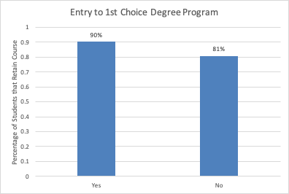
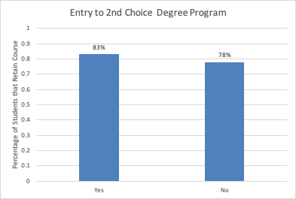
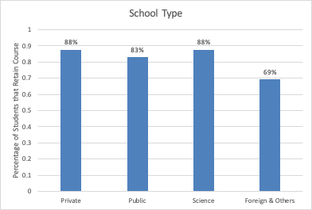
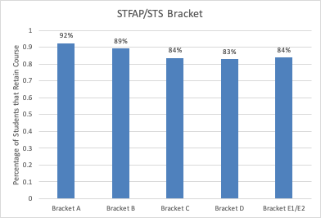
Descriptive Analysis
Results and Analysis - Course Retention
Percentage of Students that Retain Course Based on Categorical Features
Notes:
[Mico]
A student’s entry to their first choice of degree program is the leading factor of course retention among the categorical features. Of those who graduated in their initial degree program, 90% got into their first choice degree program while 81% did not. A similar trend is seen in the students who got into their second choice degree program, but this decreases the difference to 5%.
Those who came from private and science high schools have a higher chance of retaining their course than those from public high schools. Meanwhile, those who received little to no tuition subsidies from STFAP or STS have a higher chance of graduating in their initial degree program.

Slide 57
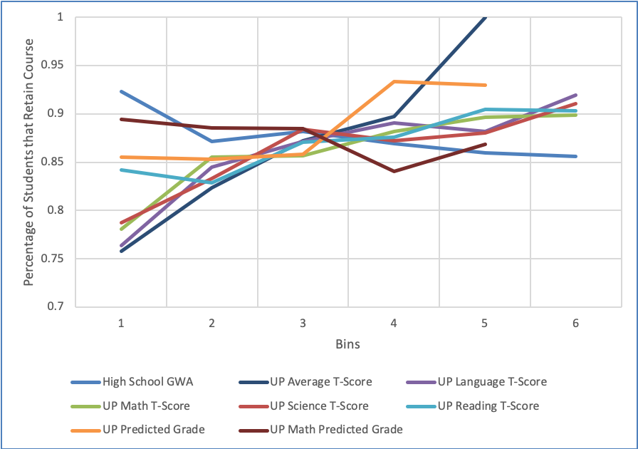
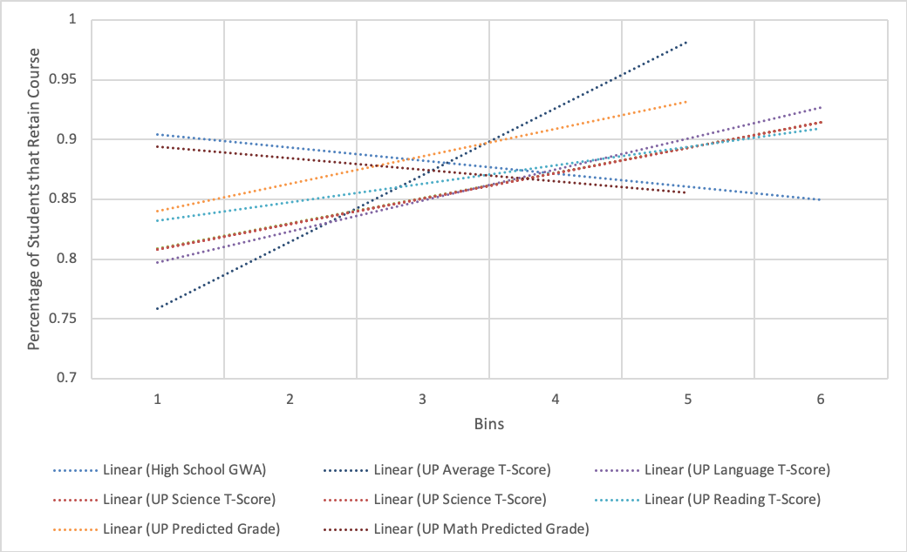
Descriptive Analysis
Results and Analysis - Course Retention
Percentage of Students that Retain Course Based on Continuous Features
Trendlines of
Continuous Features
Notes:
[Mico]
We can see here that all continuous features except for High School GWA and UP Math Predicted Grade have a positive trend meaning a higher value for the continuous features indicate a higher chance of course retention. A higher value for HSGWA and UPMPG lowers the chance of course retention. All of the continuous features that are considered for Course Retention prediction are pre-enrolment factors.

Slide 58
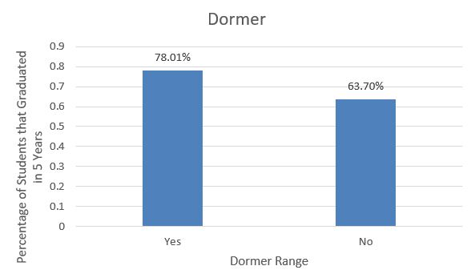
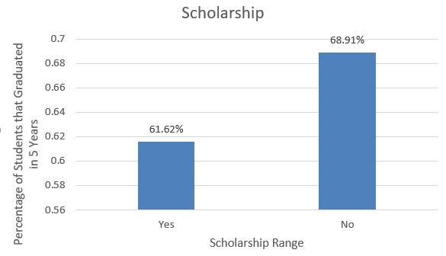
Descriptive Analysis
Results and Analysis - Time to Graduation
Percentage of Students that Graduate in 5 years Based on Categorical Features
Notes:
[Elisha]
Based on the graphs a student is more likely to graduate on time if that student has been a resident dormer over students who do not live in dormitories inside the university. It is also important to note that the number of students who dorm in the university are significantly less than the students who don’t. As for the scholarship side, there is a 7% difference between that students that have scholarships and students who did not have for time to graduation with “No” having the higher percentage.

Slide 59
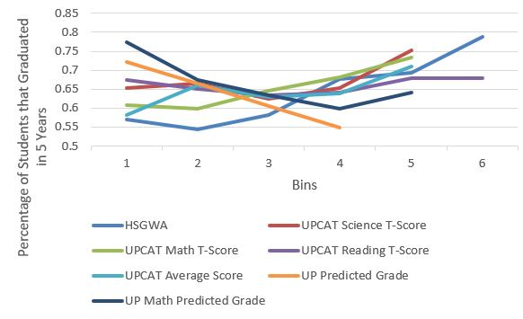
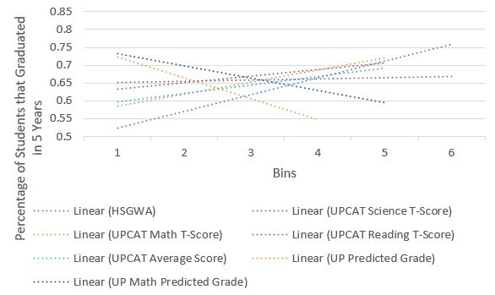
Descriptive Analysis
Results and Analysis - Time to Graduation
Percentage of Students that Retain Course Based on Continuous Features
Trendlines of
Continuous Features
Notes:
[Elisha]
We can see here that all continuous features have a positive trend meaning a higher value for the continuous features indicate a higher chance of graduating within 5 years. For the case of the UP Predicted Grade and UP Math Predicted Grade the trend is the opposite meaning a higher grade in these factors yield a lower chance of graduating within 5 years. All of the continuous features that are considered for Time to Graduation prediction are pre-enrolment factors.

Slide 60
Conclusions & Recommendations

Slide 61
Conclusions & Recommendations
Conclusions
Low graduation/retention rates to be addressed by prediction models and descriptive analysis
Risk factors have been separately identified for Course Retention and Time to Graduate
All models except for Time to Graduate model of Probabilistic Model reached 70% overall accuracy
Each model has its own benefits depending on the user’s needs
Notes:
[Regis]
As stated before, the College of Engineering has low graduation and course retention rates and this poses a problem because the college isn’t producing as much graduates as enrollees, and this makes it inefficient. With the help of these tools, hopefully these problems will be attended to.
Different risk factors were identified for course retention and time to graduate. They are separate output classes, so we tried the chi square test of independence and correlation coefficient for each. For course retention, there are 4 categorical features and 8 continuous features. Nine of these were pre-enrolment factors, then the remaining features are post-enrolment factors. Time to Graduate had different features, two of which were categorical, while the remaining seven are continuous features.
The three developed prediction models were carefully created and tuned accordingly. With enough training and tweaking, all of the models reached an overall accuracy of 70% for both course retention and time to graduate, except for the Probabilistic Model, which did not reach an accuracy of 70% for the Time to Graduate model.
While there are varying accuracies per model, each one of them has their own strengths and weaknesses. When it comes to viewing the risk factors that the model relies on, both Decision Trees and Probabilistic Model prevail over SVM because of their white-box approach. If accuracy is the only metric, then SVM is the best for predicting time to graduate while Probabilistic Model has the highest accuracy for course retention. For being a robust and stable model, SVM is the best among the three because the training set and test set accuracies for both time to graduate and course retention are close and has the least difference among the others. If everything is important, then Decision Trees would be the best option as it has the ability to view the features while being the 2nd best in accuracy for both time to graduate and course retention models.

Slide 62
Conclusions & Recommendations
Conclusions
All continuous features from Course Retention have a positive trend except for UPMPG and HSGWA
Categorical features from Course Retention are entry to first choice degree program and type of high school
Continuous features from Time to Graduate all have a positive trend except for Reading Comprehension
Other features for Time to Graduate are being a dormer and the scholarship
Notes:
[Regis]
After analyzing the data, we have generated trends of the different features and how they relate to a student’s time to graduate or their course retention. For course retention, the features with continuous data all have positive trends, meaning the higher the number, the more likely it is to graduate in the same course the student initially enrolled in, with the exception of UPMPG and HSGWA. The backwards trend pushes us to the conclusion that students who did have a high grade in high school had a different attitude towards their outlook to college. Those who did well in math in high school and in the math portion of the UPCAT became complacent in college, while the ones who did not have a high grade worked harder to achieve a better standing. The categorical data for course retention are entry to first choice degree program and type of high school.
The continuous features from Time to Graduate also have a positive trend except for Reading Comprehension. This trend is the only one with an almost zero average slope. The people with an average score have a lower chance of graduating on time compared to the rest with either a low reading comprehension or a high reading comprehension.

Slide 63
Conclusions & Recommendations
Recommendations
Obtain data pertaining to student performance to improve predictions and understanding of trends
Use an ensemble of prediction models for integration into an application.
Check the correlation of each feature and explore other analysis tools that accommodate multi-class categorical features
Notes:
[Mico]
The features that are utilized in our project consist mainly of pre-enrolment and post-enrolment factors that do not reflect a student’s academic performance. According to related works that were studied, a student’s academic performance is one of they key indicators of student success. Thus, including data that includes the academic performance of students per semester might allow the prediction models to better distinguish the multi-class outputs and lead to a better understanding of the risk factors.
An ensemble of prediction models is recommended if the models are to be integrated into an application. Based on what was achieved in the project, each prediction model has their own benefit: the Decision Trees model could be used for looking at the risk factors that affected the prediction, the Probabilistic Model display the probability that the risk factors are indeed the key indicators of the prediction, and the Support Vector Machine model could be used for the prediction outputs.
For the descriptive analysis, it might be worth looking at the correlation of the features. This might lead to a better understanding of the trends (e.g. a low High School GWA could lead to a low UPCAT Average T-Score) and thus giving faculty advisers more analysis to base their advice to students on. We also recommend exploring other analysis tools that can fully accommodate multi-categorical categorical features such as School Type and STFAP/STS Bracket as converting their values to numerical for use with descriptive and regression statistics introduce ordinality that do not have any correlation to the classes of the features.

Slide 64
THANK YOU!

